Slide 1




Customer Purchase Behavior Analysis
By Jana Mostafa

Slide 2

BUSINESS GOALS
Predicting Online Retail Revenue.
Customer Purchase Behavior Analysis.
Revenue Forecasting for E-Commerce.
Online Retail Sales Prediction.

Slide 3
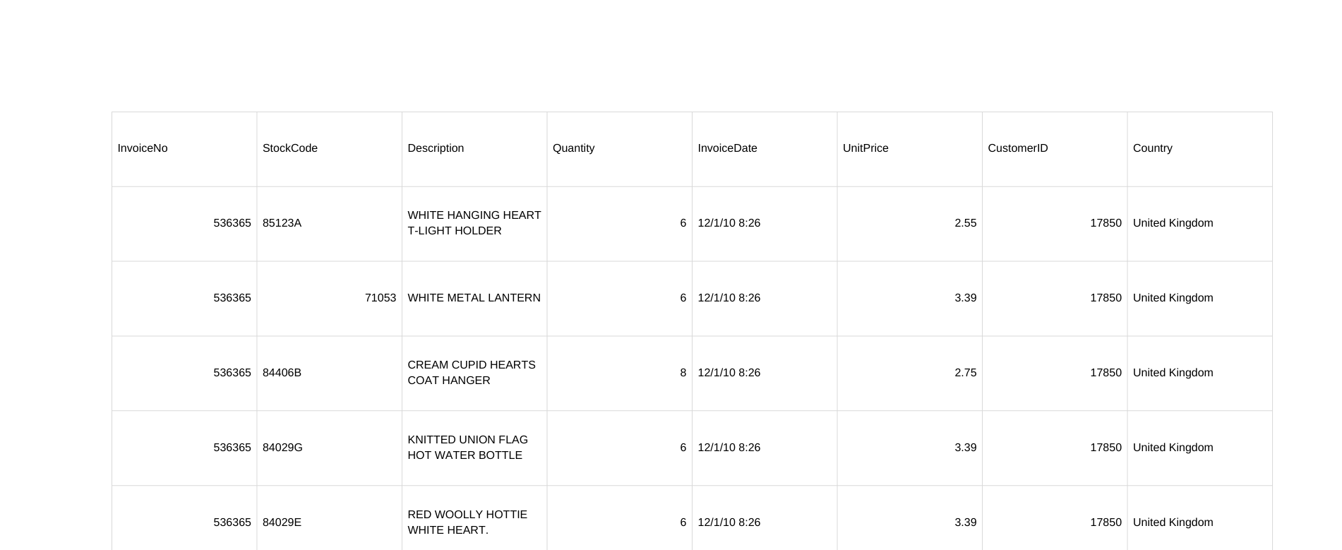
Data

Slide 4
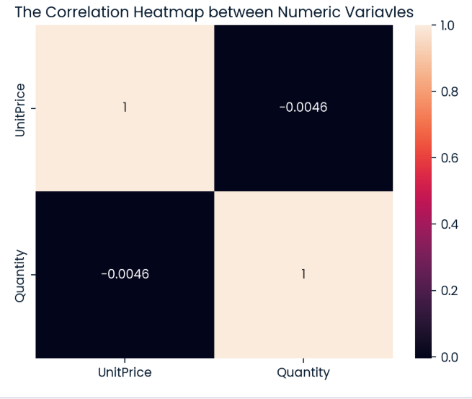
Findings
This diagram shows:
The correlation beyween unit price and itself is 1 so it is totally positive and the same as quantity and itself, but the correlation between quantity and unit price is negative.

Slide 5
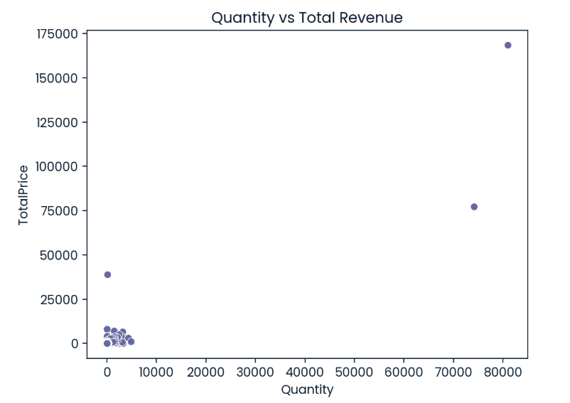
Findings
This diagram shows:
The quantity that the customers buy is high in the low price products more than the high price.

Slide 6

Outcomes
We have two models - Linear Regression Model and Random forest Regression
UnitPrice
Linear Regression Model
Price 1
Random Forest Regression Model
Quality
Price 2

Slide 7
Outcomes
Two metrices - R squared and RMSE (Root Mean Squared Error)
Metrics | R2 Score | RMSE
Purpose | Good fit of data | Accuracy
Range | 0 - 1 | Depend on the scale of the target variable.

Slide 8
Outcomes
The Random Forest Regression Model is performing better
Model Name | R2 Score | RMSE
Linear Regression | 0.53 | 224
Random Forest Regression | 0.84 | 391

Slide 9
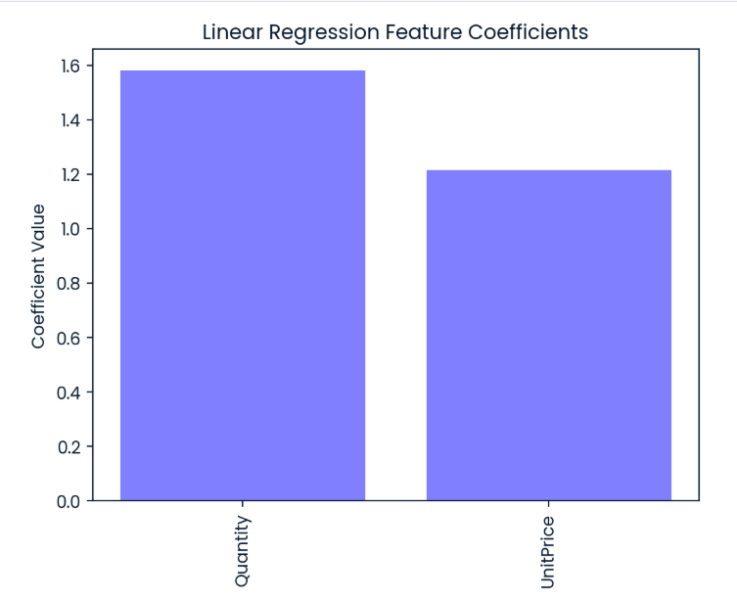
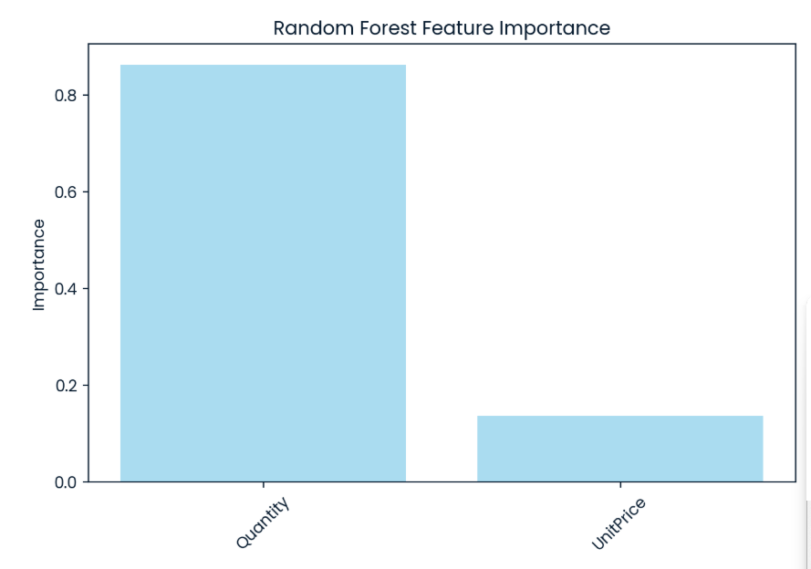
Outcomes
Our KPI - Percentage of Predictions Within ±15% of Actual Revenue

Slide 10
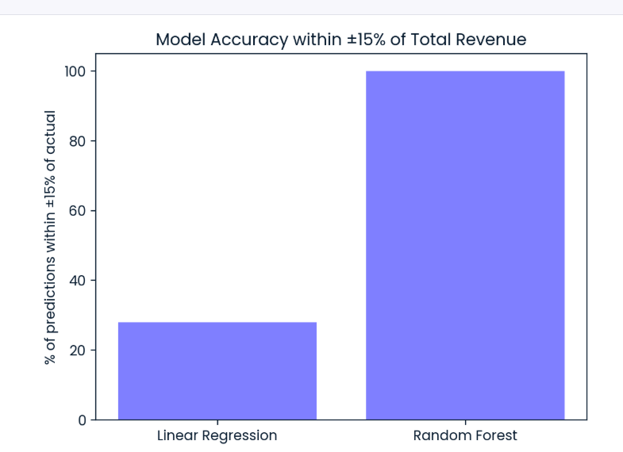
Outcomes
Accuracy for the Random Forest Regression Model

Slide 11
Recommendation
To improve the accuracy and reliability of transaction revenue predictions, we can plan to deploy the Random Forest Regression model into production. This model provides more accurate forecasts with R² = 0.84 and RMSE = 391, helping the business optimize inventory and pricing decisions. I recommend the following steps to ensure the model is effectively deployed and continuously improved:
Test the model on the most recent sales data and compare its predictions to actual revenue to identify any gaps.
Identify and fix errors after testing to improve prediction accuracy.
Deploy the model using an efficient strategy, such as a web-based dashboard or an API integrated into the sales system.
Continuously improve the model by collecting new transaction data, engineering additional features (e.g., seasonality, promotions), and fine-tuning parameters to better capture sales patterns.
By following these steps, the business can rely on the model for faster and more informed decision-making, ensuring stock levels and pricing strategies are optimized automatically.

Slide 12
THANK YOU

